Slide 1

Optimizing Search Efficiency: Differential Learning & Differentiable Search Index Approaches
Information Retrieval
May 8, 2024
Navid Azimi, Alireza Rafiei, Mohammad Hashemi
Department of Computer Science, Emory University
1

Slide 2
Introduction
Motivation
The efficacy of IR systems in providing pertinent document rankings in response to user queries is essential
Traditional IR systems commonly employ an index-then-retrieve pipeline (not always the most efficient approach!)
Alternative approaches like the Differentiable Search Index (DSI) aim to integrate indexing and retrieval processes into a unified model. By doing so, they offer the potential for more seamless and efficient document ranking in response to user queries.
Problems
Sequential nature of traditional IR methods: Indexing occurs first, followed by retrieval
Latency issues, especially when dealing with large datasets or in real-time search scenarios
Struggle with handling dynamic or evolving datasets: The index becomes outdated over time
Stale search results and diminish the user experience
Goal
Inspired by the differential learning approach and Differentiable Search Index concept, our goal is to merge these traditionally separate stages and developing a unified model, designated as 'f', utilizing a sequence-to-sequence architecture, which handles user queries ('q') and employs an auto-regressive approach to generate relevant document IDs.
2

Slide 3
Dataset
The MS MARCO dataset Pre-built index provided by Pyserini library
1
Building Resources
documents (dictionary): document ID (docid) as key, a dictionary with field 'raw’ (containing the raw text as string) as value
queries (dictionary): query ID as key , a dictionary with field 'raw' (containing the raw text as string) and 'docids_list' (containing the list of correlated document IDs) as value
2
Computing Word2Vec Embeddings for queries and documents
Using the trained Word2Vec model (on corpus data, containing all the processed ’raw’ data)
Processed ’raw’ data: Converted to lowercase, tokenized, and stopwords and punctuation removed
Created 2 types of embeddings for each query/document: emb, obtained as the average of the embeddings of all words, and first_L_emb, obtained by concatenating the embeddings of the first MAX_TOKENS words
3
Creating Datasets for Siamese Models
Pairwise Dataset (query, document, relevance):
Designed for pairwise learning, where each sample consists of a query paired with a document
Triplet Dataset (query, doc+, doc-):
Designed for triplet learning, where each sample comprises a query along with a positive and a negative document for training
3

Slide 4
Dataset
Example of Pairwise/Triplet Datasets
4
Creating Datasets for Sequence-to-Sequence (seq2seq) Model
Document Dataset (encoded document, encoded docid):
Designed to facilitate training Seq2Seq models by providing documents as input sequences
Retrieval Dataset (encoded query, encoded docid):
Designed for Seq2Seq models used in retrieval tasks. It pairs documents with corresponding queries for training
Documents and queries encodings are computed using the T5-small tokenizer, and we choose to pick the first L=32 tokens for representing the documents, and the first L=9 for representing the queries.
Example of Document/Retrieval Datasets
4

Slide 5
Siamese Neural Network: SNN-Convolutional (Baseline)
Siamese Neural Network: Neural network architecture that consists of two identical subnetworks, which have the same architecture and share the same parameters (weights)
Learn the similarity or dissimilarity between pairs of inputs (Differential learning approach)
1
Convolutional Siamese Neural Network (using Word2Vec embeddings)
Steps:
Changing Dataset Return Type: The dataset pairs_dataset return type is modified to 'emb' (Word2Vec embeddings)
Initializing Siamese Network (Parameters):
  input_size: Set to the dimensionality of Word2Vec embeddings
  conv_channels: The number of channels for convolutional layers
Training the Model (Parameters):
  pairs_dataset, max_epochs, batch_size, split_ratio, etc.
Inability to effectively discriminate between relevant and random documents, assigning high similarity scores to irrelevant documents
 | MAP |  | nDCG@10 |  | Precision@10 |  | Recall@1K
 | Train | Test | Train | Test | Train | Test | Train | Test
CNN-SNN | 0.1181 | 0.0500 | 0.1937 | 0.1782 | 0.0399 | 0.0100 | 0.3900 | 0.5
5

Slide 6
Siamese Neural Network: SNN-Attention
2
Siamese-Attention-Net Transformer (using token embeddings)
Attention network: Designed to identify the highest correlations amongst words within a sentence, assuming that it has learned those patterns from the training corpus
This enables learning representations based on token-level information (capture dependencies regardless of their distance in the input sequence. )
Generates a relevance score using cosine similarity
Steps:
Changing Dataset Return Type to Token Embeddings: The return type of the dataset pairs_dataset is adjusted to 'first_L_emb' (embeddings of first L tokens) - Use the stack of the first MAX_TOKENS embeddings (first_L_emb) of queries and documents
Initializing Siamese Transformer Network (Parameters):
  embedding_size (total): Set to the product of EMBEDDING_SIZE and MAX_TOKENS
Training the Model (Parameters): pairs_dataset, max_epochs, batch_size, split_ratio, etc.
This model also struggles to distinguish relevant documents from random ones, frequently attributing high scores to both
 | MAP |  | nDCG@10 |  | Precision@10 |  | Recall@1K
 | Train | Test | Train | Test | Train | Test | Train | Test
SNN-Att | 0.0999 | 0.0 | 0.034 | 0.0236 | 0.01 | 0.0 | 0.08 | 0.0499
6

Slide 7
Siamese Neural Network: SNN-Contrastive
3
Contrastive Siamese Network (Contrastive Learning Approach with Triplet Loss)
Triplet loss function: The network learns by comparing a set of three inputs: an anchor sample, a positive sample (similar to the anchor), and a negative sample (dissimilar to the anchor). The goal is to bring the anchor and positive sample embeddings closer while pushing the negative embedding further away.
Steps:
Changing Dataset Return Type to Embeddings: The return type of the dataset `triplets_dataset` is adjusted to 'emb' (embeddings)
Initializing Siamese Lightning Module (Parameters):
  input_size: Set to the dimensionality of embeddings (EMBEDDING_SIZE)
  margin: Defines the margin for the triplet loss function
  arch_type: Specifies the architecture type, set to ‘fully_connected'
Training the Model (Parameters): triplets_dataset, max_epochs, batch_size, split_ratio, etc.
This method, by leveraging the principles of contrastive learning, showed notable effectiveness over previous baselines and effectively discerns between similar and dissimilar query-document pairs
 | MAP |  | nDCG@10 |  | Precision@10 |  | Recall@1K
 | Train | Test | Train | Test | Train | Test | Train | Test
SNN-Cons | 0.2725 | 0.1706 | 0.3784 | 0.3211 | 0.1659 | 0.1599 | 0.7319 | 0.666
7

Slide 8
DSI Transformer-Based Model
1
Sequence-to-Sequence Model
Model’s architecture: A transformer-based encoder-decoder that involves three transformer layers for each component. Encoder plays the role of indexing, in which the model has to acquire the documents knowledge to map every document to its related docid. Meanwhile, the decoder is tasked with retrieval, generating the complete target sequence from a given query. Ranking is conducted according to semantic similarity.
Steps:
Initializing the sequence-to-sequence model (Parameters):
  nlayers: Set the number of transformer layers for the encoder-decoder model
  nhead: The number of heads in the multi-head attention models
  nhid: The dimension of the feedforward network model
  droupout: The dropout rate for each layer
Training the Model (Parameters):
  tokenized_dataset, Transformer_module, max_epochs, batch_size, split_ratio, etc.
This model can be a more generalizable one, but needs more powerful computational racecourse for training
 | MAP |  | nDCG@10 |  | Precision@10 |  | Recall@1K
 | Train | Test | Train | Test | Train | Test | Train | Test
Seq-2-Seq | 0.0682 | 0.0684 | 0.0909 | 0.0906 | 0.0167 | 0.0167 | 0.1678 | 0.1671
8

Slide 9
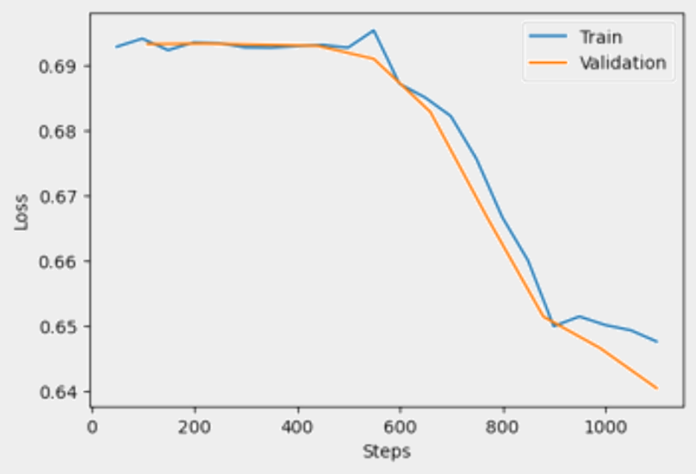
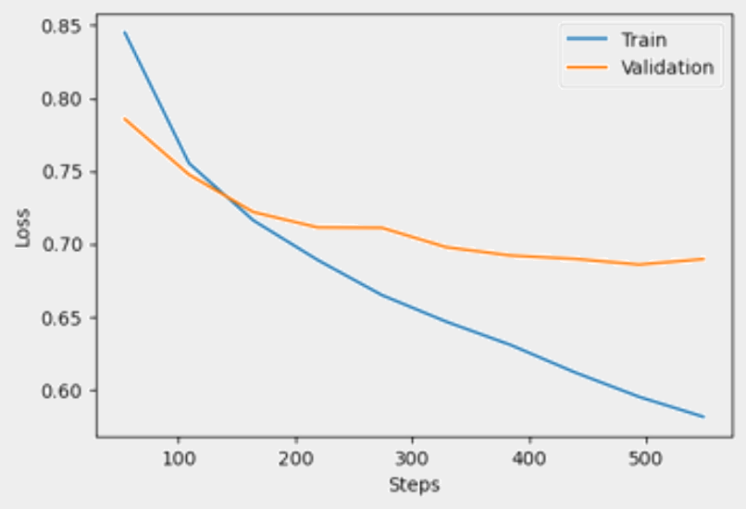
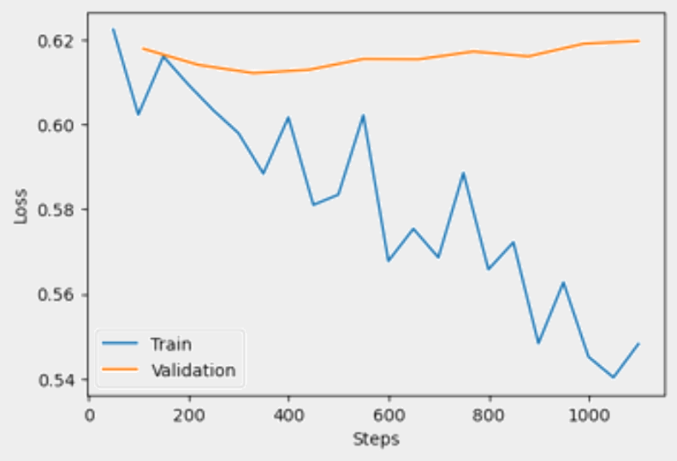
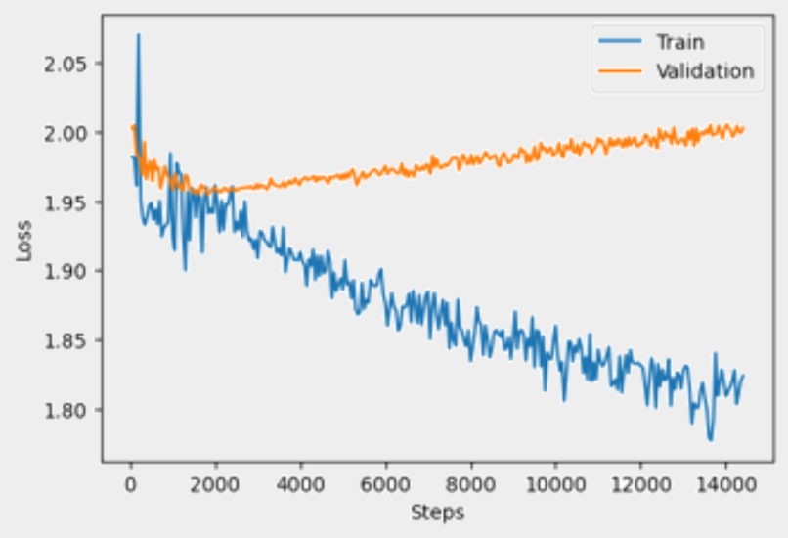
Loss During the Models’ Training Process
Siamese Network
Siamese-attention Network
Siamese-contrastive Network
Sequence-to-Sequence Model
9

Slide 10
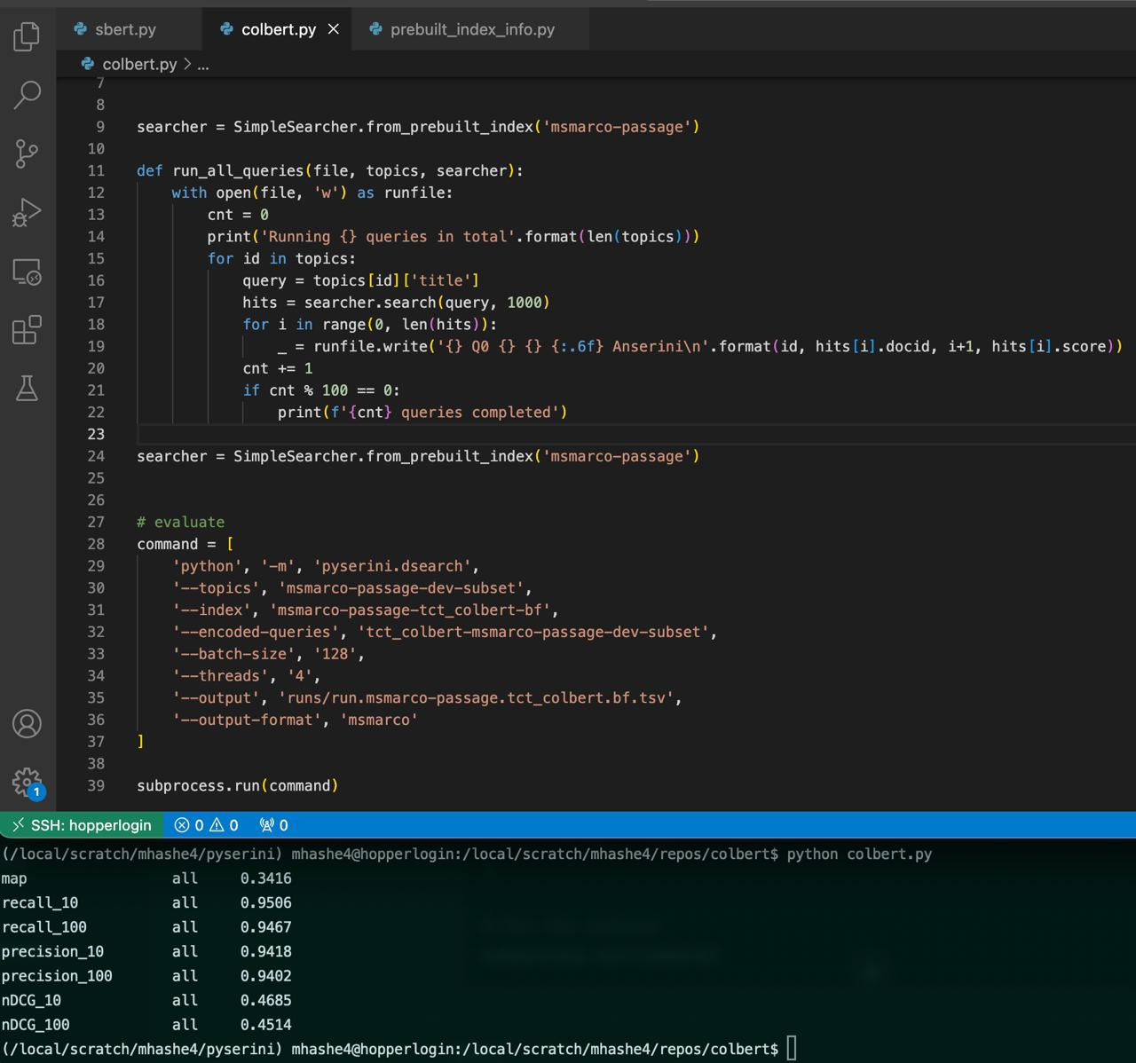
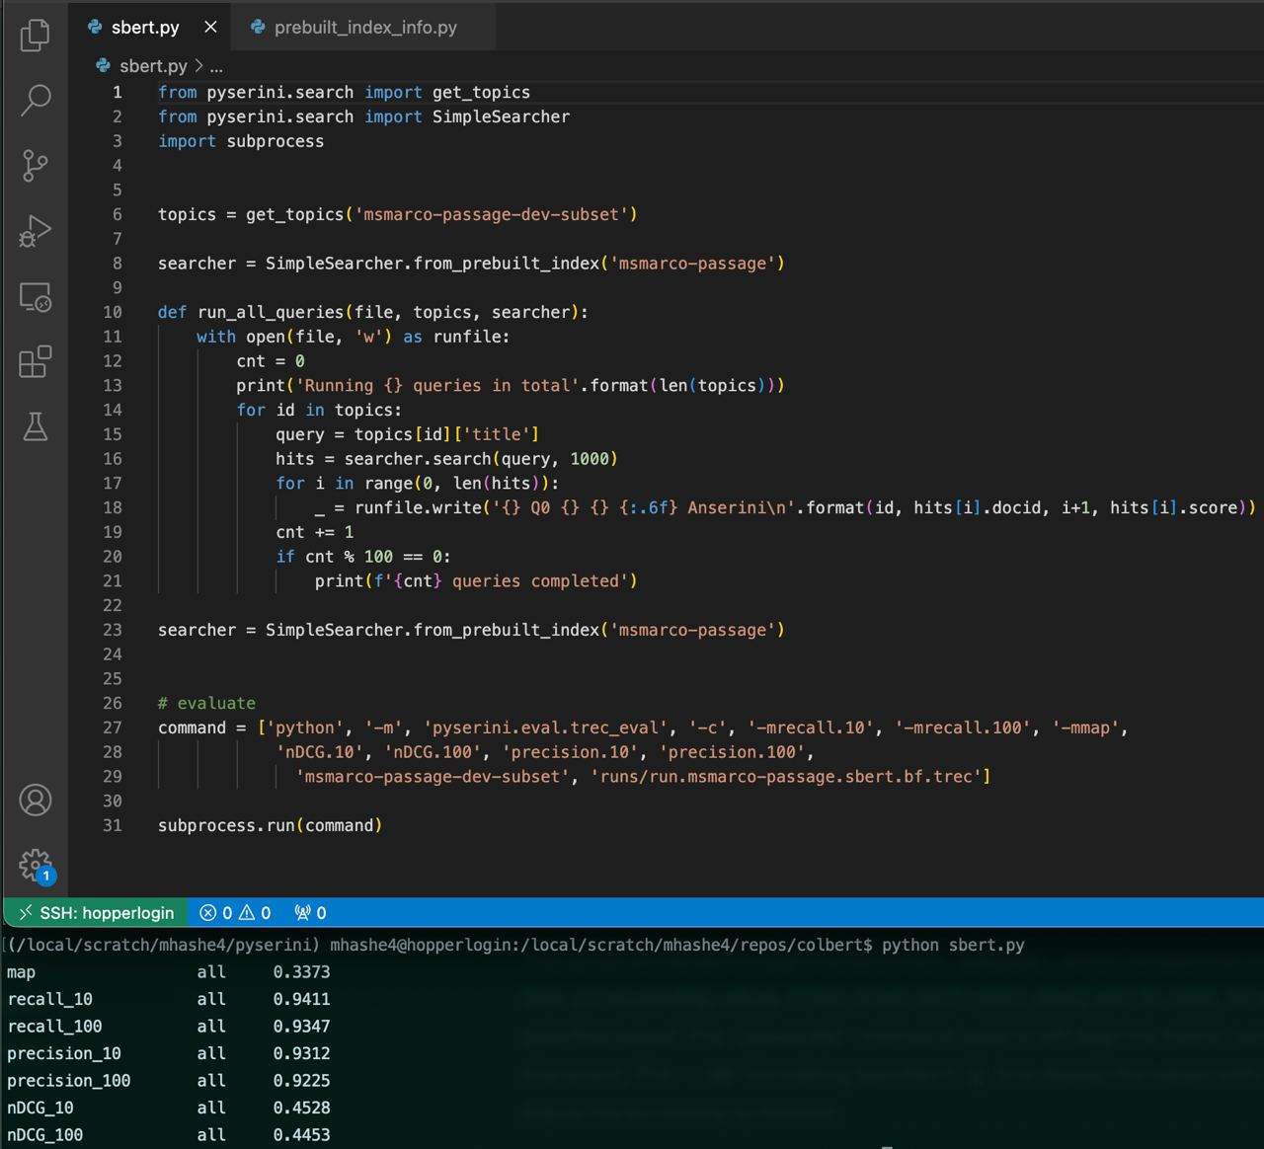
ColBERT & SBERT
ColBERT on MS MARCO Dataset
CS Department’s Hopper server: Microway server with eight Titan RTX GPUs
1
SBERT on MS MARCO Dataset
Pyserini Library’s Prebuilt Index
2
Both of these models outperform our Siamese and sequence-to-sequence models, but they require extensive computational resources.
Results
 | MAP | nDCG@10 | Precision@10 | Recall@10
ColBERT | 0.3416 | 0.4685 | 0.9418 | 0.9506
SBERT | 0.3373 | 0.4528 | 0.9312 | 0.9411
10

Slide 11
Conclusion
Evaluation Metrics
In congruence with: Pyserini Reproductions for MS Marco Passage
MAP, nDCG@10, Pr@10, and R@1K
Comparing the Results
 | MAP |  | nDCG@10 |  | Precision@10 |  | Recall@1K
 | Train | Test | Train | Test | Train | Test | Train | Test
CNN-SNN | 0.1181 | 0.0500 | 0.1937 | 0.1782 | 0.0399 | 0.0100 | 0.3900 | 0.5
SNN-Att | 0.0999 | 0.0 | 0.034 | 0.0236 | 0.01 | 0.0 | 0.08 | 0.0499
SNN-Cons | 0.2725 | 0.1706 | 0.3784 | 0.3211 | 0.1659 | 0.1599 | 0.7319 | 0.666
Seq-2-Seq | 0.0682 | 0.0684 | 0.0909 | 0.0906 | 0.0167 | 0.0167 | 0.1678 | 0.1671
1
According to our observations, DSI can make the training process faster, and needs less computational resources for IR tasks
But might not show better efficiency compared to the index-then-retrieve approaches
Future Works
If computational resources are available, we can evaluate the trained models using a higher number of epochs
A comprehensive comparison in terms of time, computational costs, scalability, and efficiency between the developed models and other index-then-retrieve pipelines
11

Slide 12
References
1
Transformer memory as a differentiable search index
Tay, Y., Tran, V., Dehghani, M., Ni, J., Bahri, D., Mehta, H., ... & Metzler, D. (2022), Advances in Neural Information Processing Systems, 35, 21831-21843.
2
Fully Convolutional Siamese Networks for Change Detection
Daudt, R. C., Le Saux, B., & Boulch, A. (2018, October), In 2018 25th IEEE international conference on image processing (ICIP) (pp. 4063-4067). IEEE.
3
Siamese hierarchical attention networks for extractive summarization
González, J. Á., Segarra, E., García-Granada, F., Sanchis, E., & Hurtado, L. I. F. (2019), Journal of Intelligent & Fuzzy Systems, 36(5), 4599-4607.
4
Together we stand: Siamese networks for similar question retrieval
Das, A., Yenala, H., Chinnakotla, M., & Shrivastava, M. (2016, August), In Proceedings of the 54th Annual Meeting of the Association for Computational Linguistics (Volume 1: Long Papers) (pp. 378-387).
5
Beamqa: Multi-hop knowledge graph question answering with sequence-to-sequence prediction and beam search
Atif, F., El Khatib, O., & Difallah, D. (2023, July), In Proceedings of the 46th International ACM SIGIR Conference on Research and Development in Information Retrieval (pp. 781-790).
12

Slide 13
?
Thank You!
13

